Slide 1
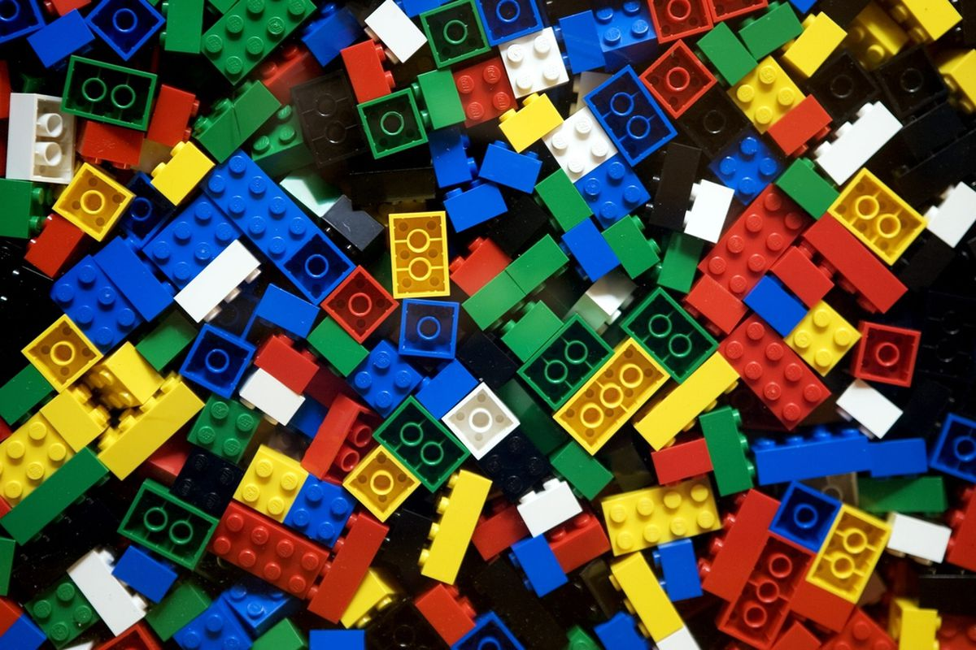
Ultimate Lego food Dispenser
By GIDD Corporate®

Slide 2
Idea

Slide 3
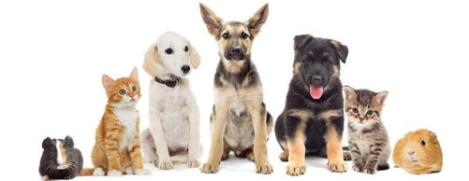
Idea
With the objective of bringing to the GIDD Corporate® associates who own pets comfort and less worries when they're out. With the new product our clients can easily be out of their houses for few days and we can assure that your pet will be fed!

Slide 4
Process

Slide 5
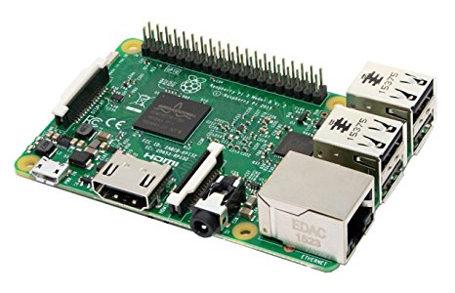
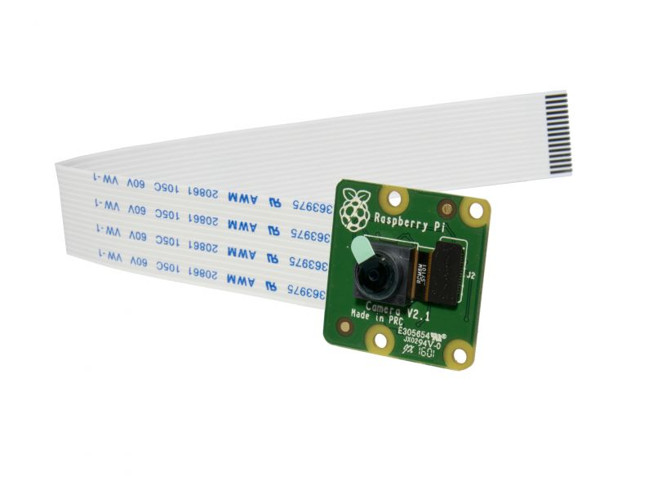
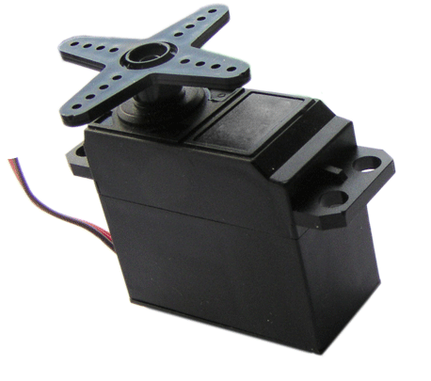
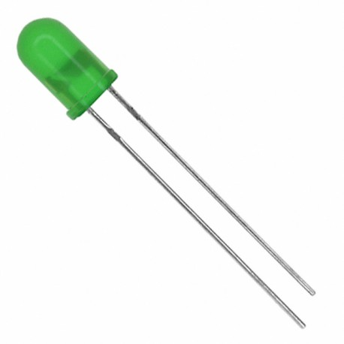
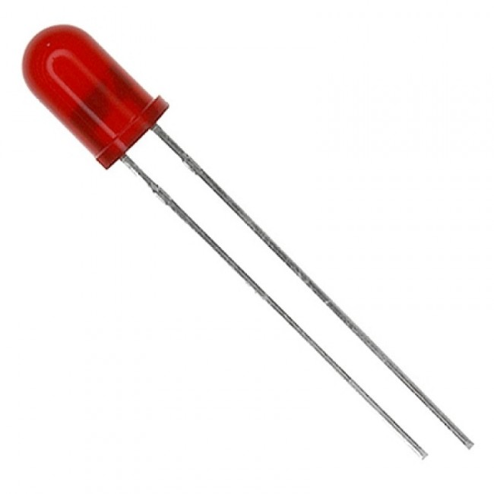
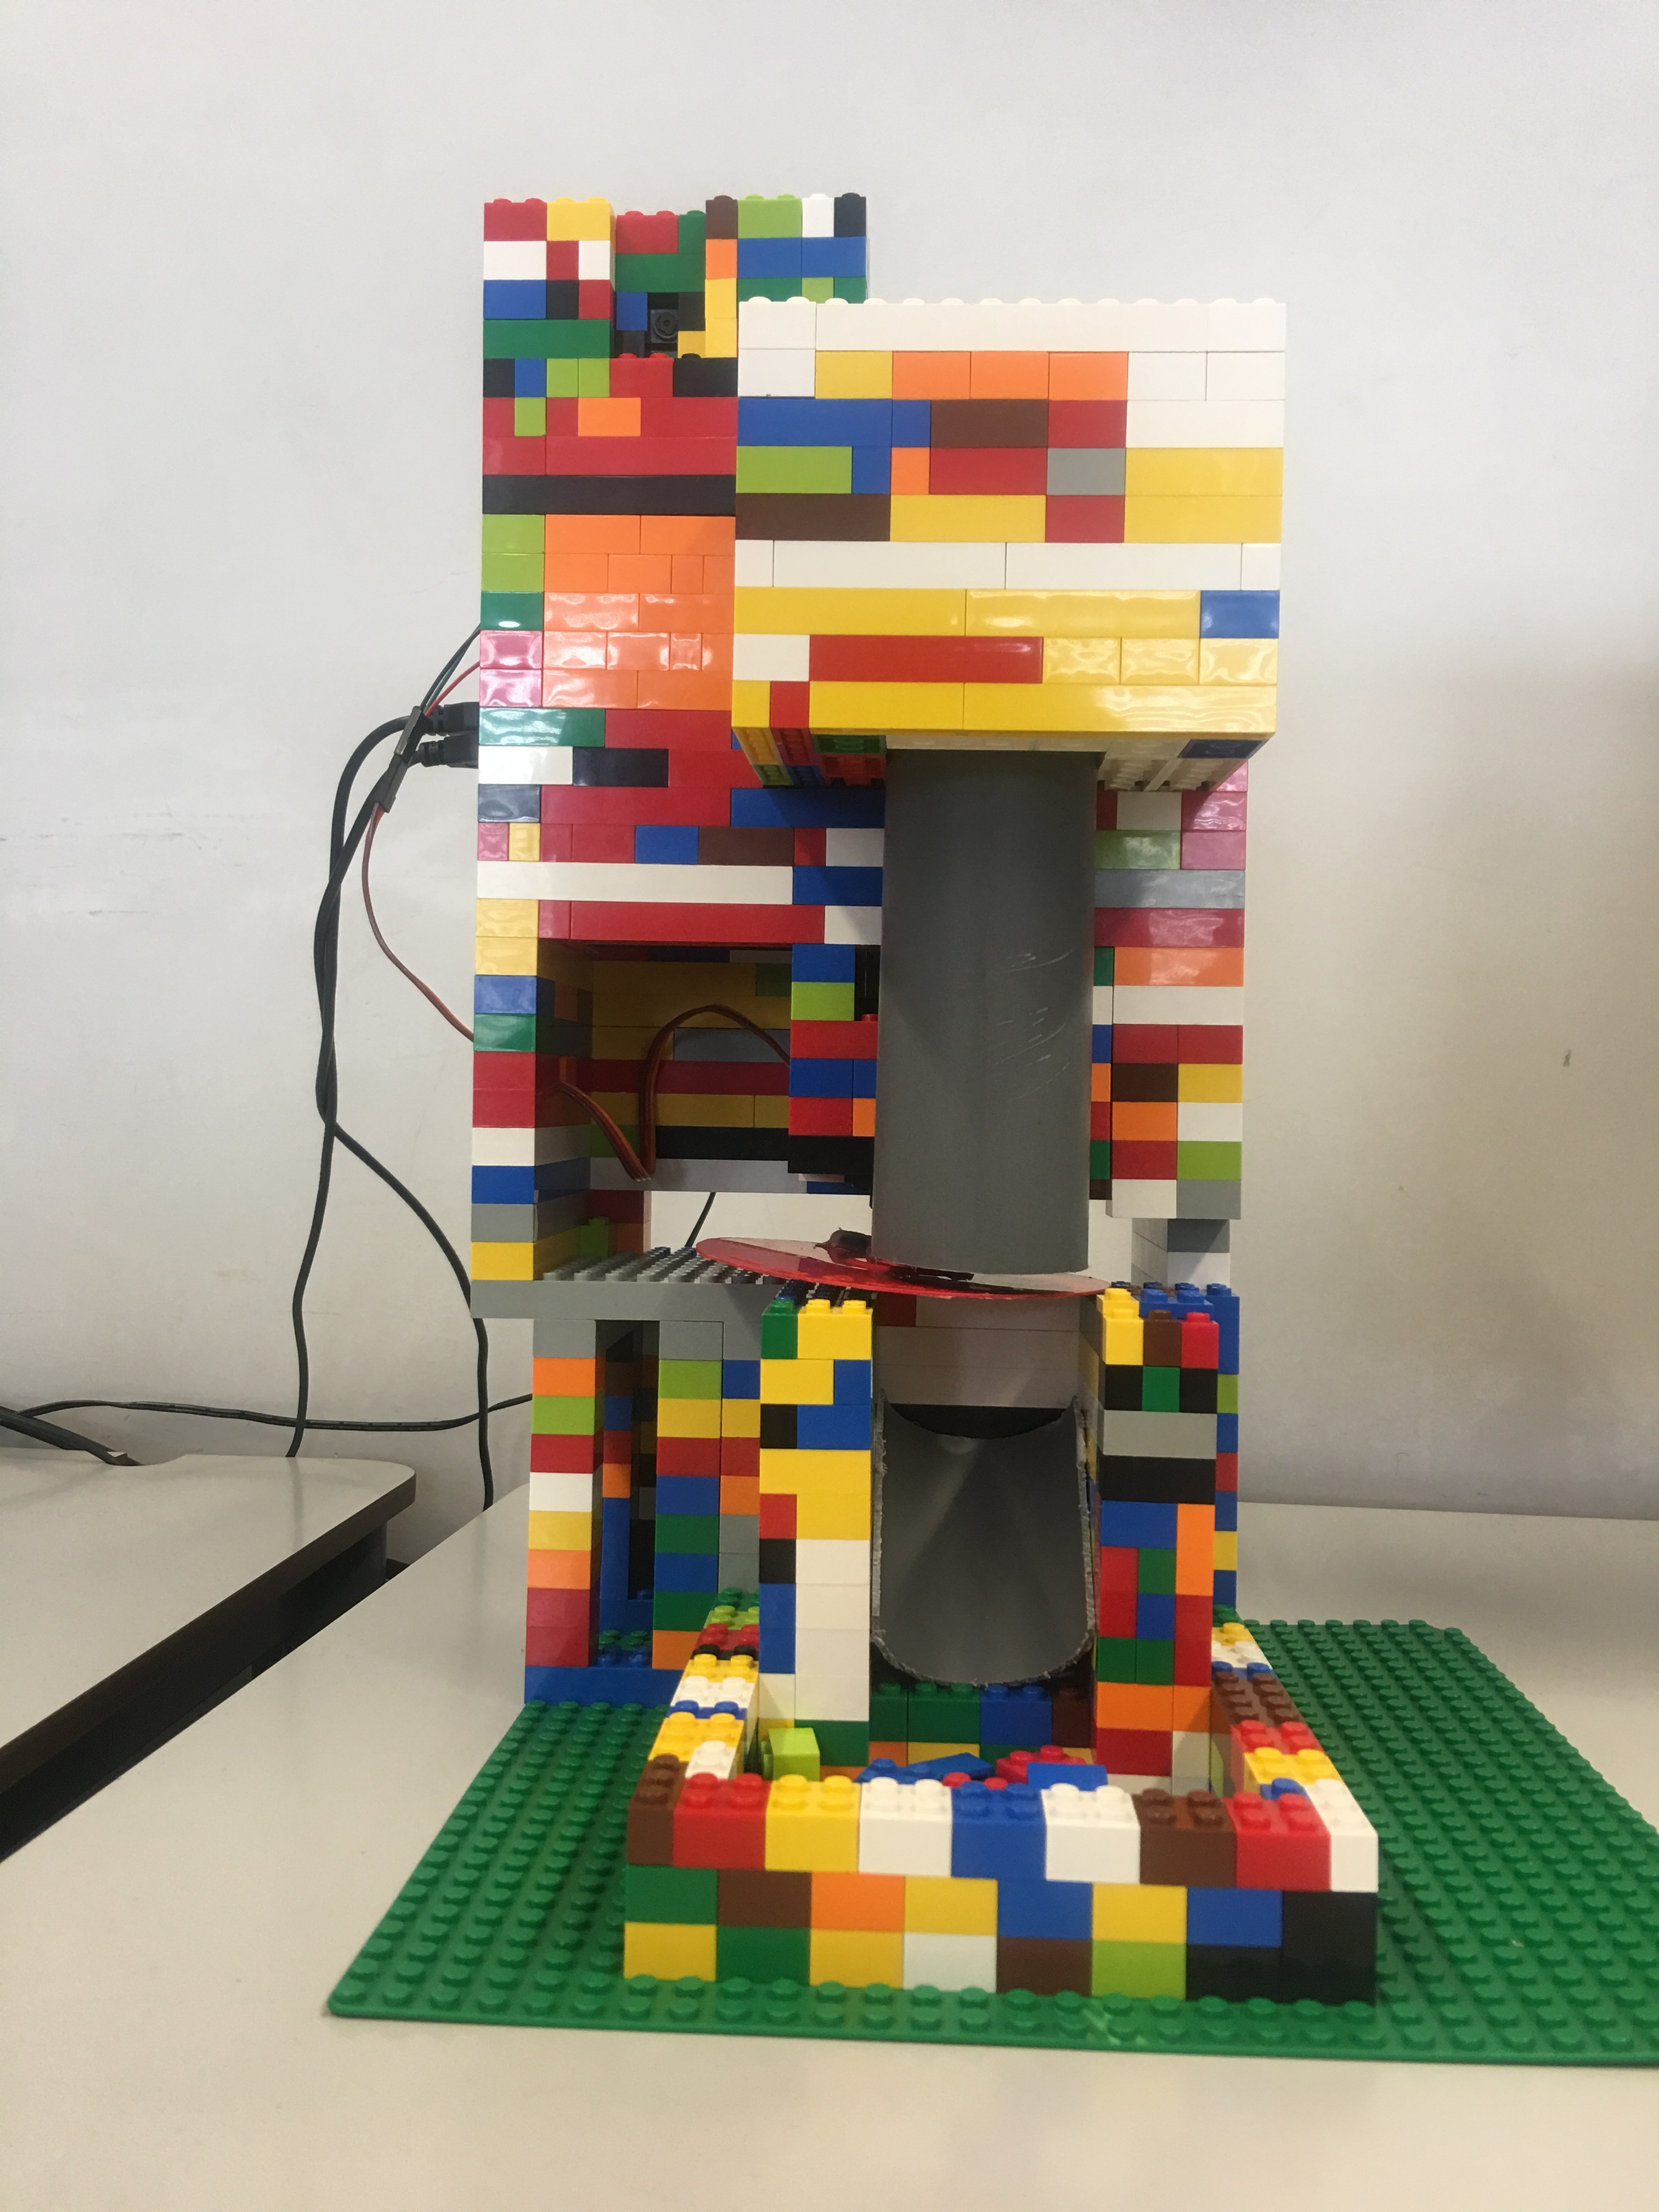
Process
Programed our RaspberryPi
Built the food dispenser with Legos
Connected the RaspberryPi to the camera, the motor and the leds
Tried it out

Slide 6
Project

Slide 7

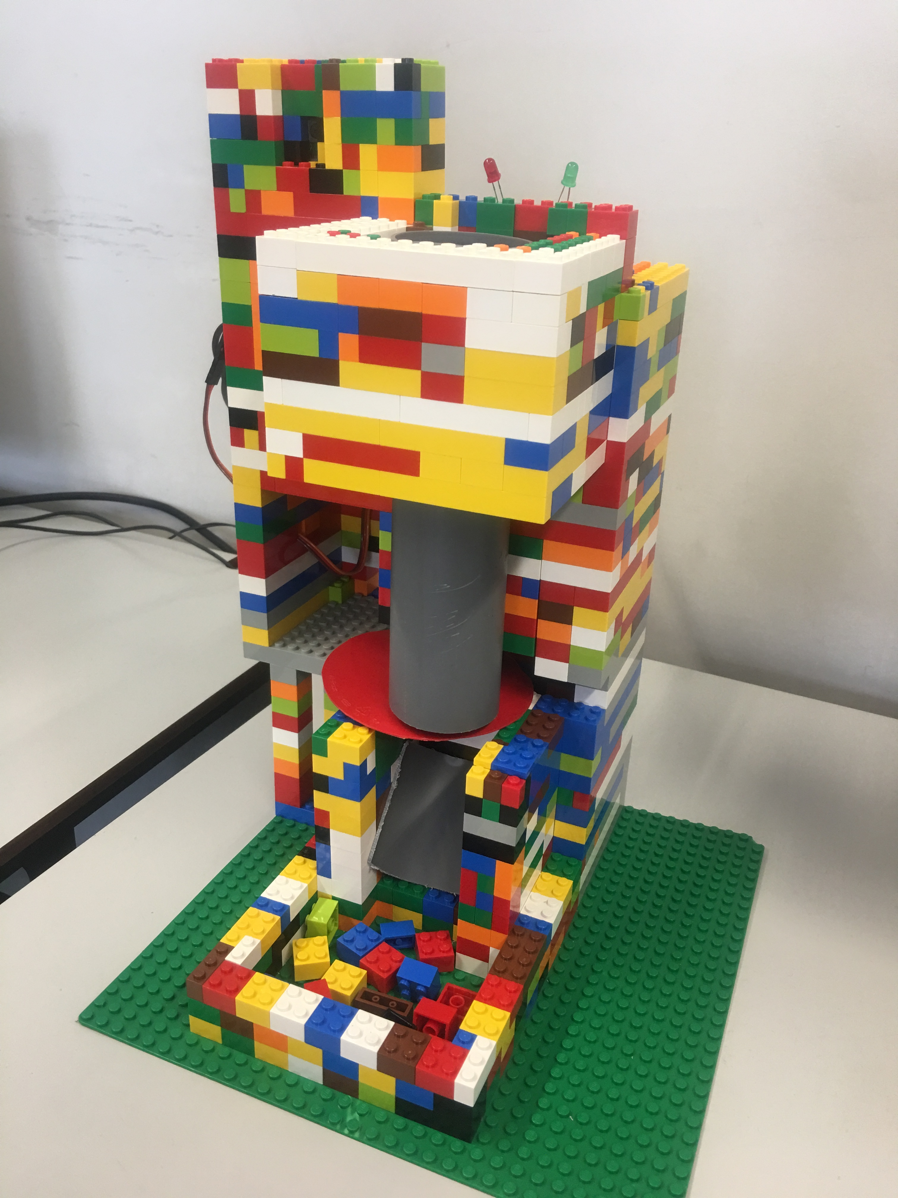
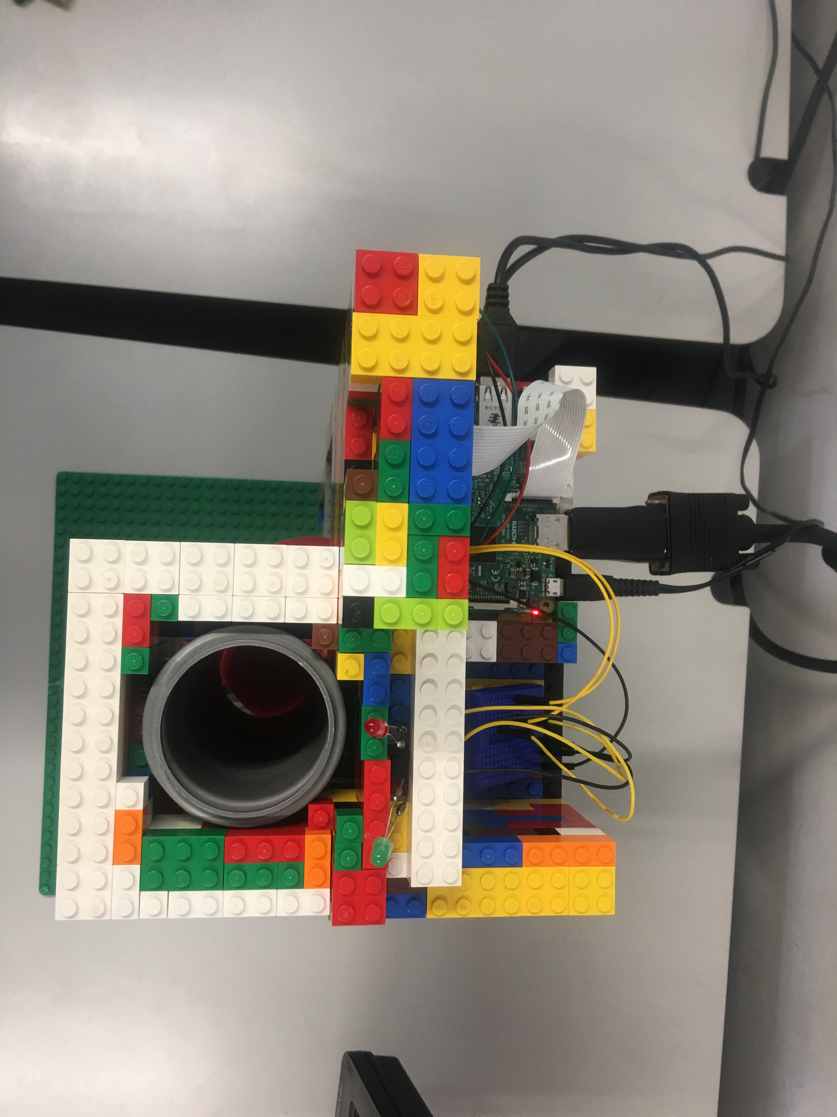

Project
Brand new ULTIMATE LEGO FOOD DISPENSER by GIDD Corporate®:
It feeds your pet
Takes a stopmotion video of your pet while he's eating
Sends the video directly to your e-mail account

Slide 8
Demonstration

Slide 9
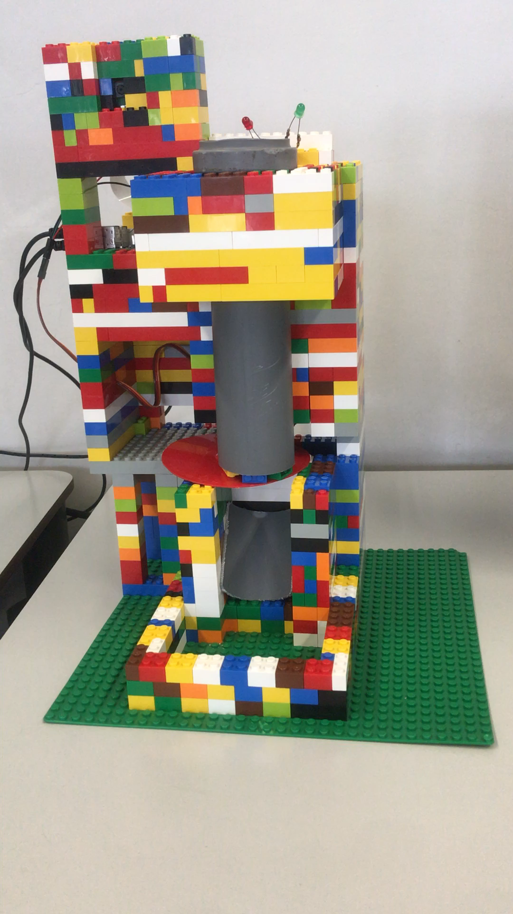
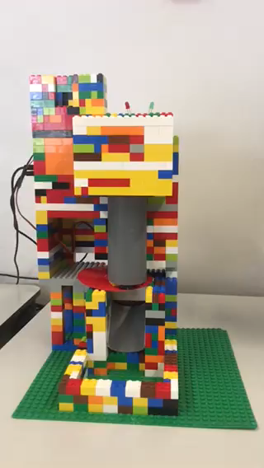
Demonstration

